Slide 1

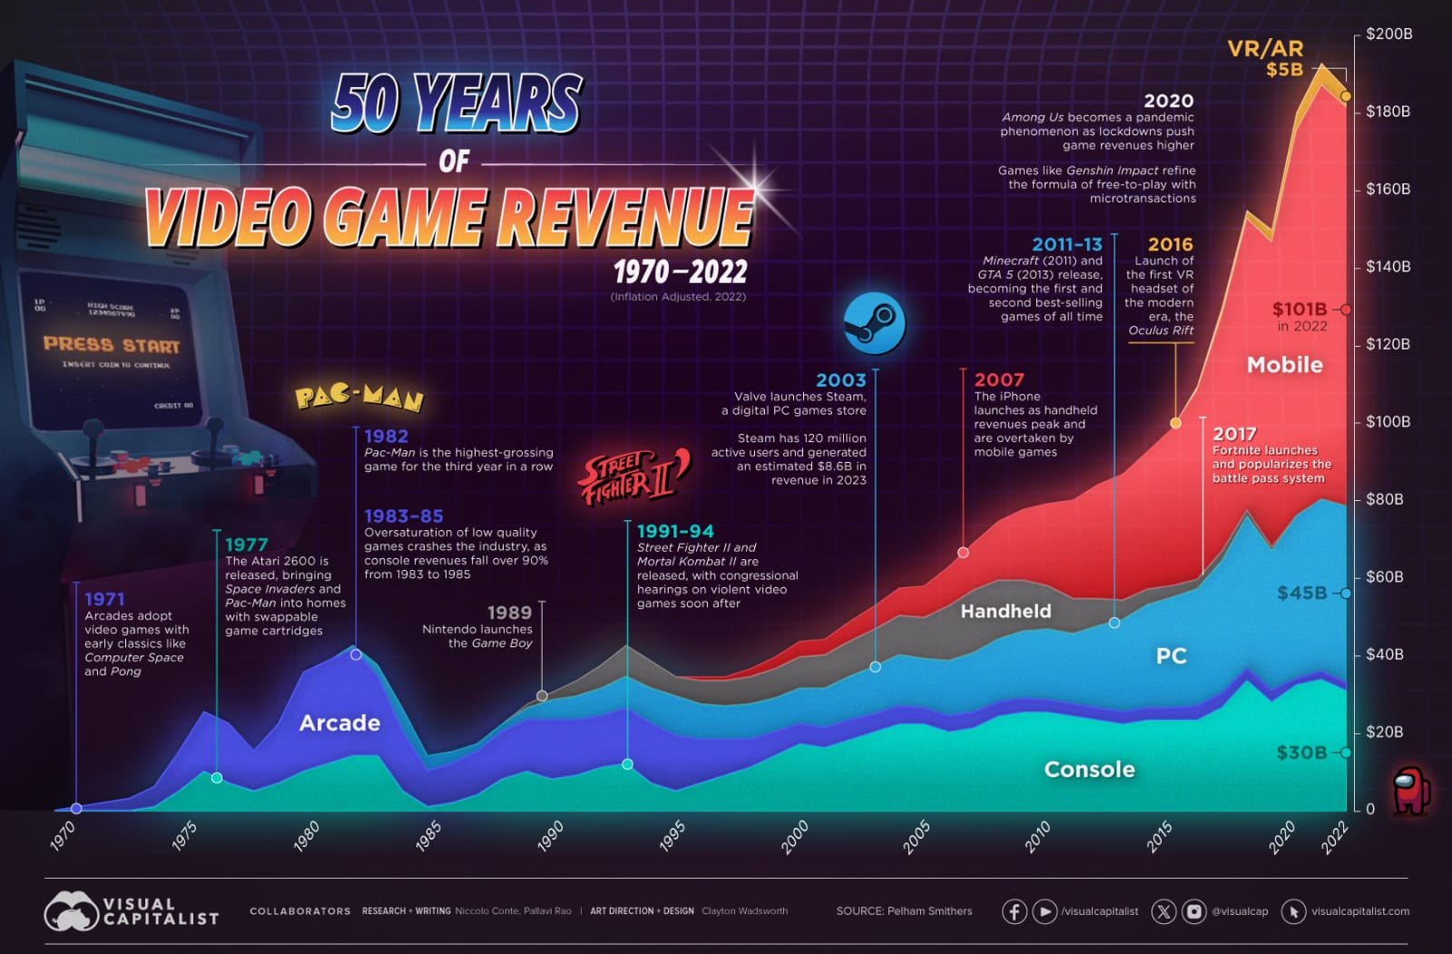
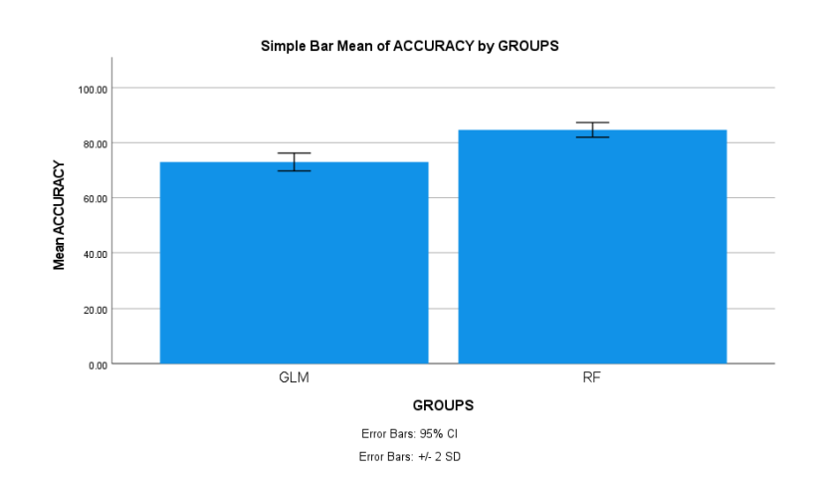
Name: Mr. Jonnalagadda Sai Chandu Register Number: 192211216
Guided by K.V. Kanimozhi
Ms. Poorani.S
Guided by Dr. Mary Valantina. G
Enhanced Prediction of Sales in Video Games using Random Forest Algorithm in Comparison with Generalized Linear Model Algorithm to Improve Accuracy
INTRODUCTION
This study focuses on comparing the Random Forest Algorithm with the Generalized Linear Model (GLM) Algorithm, aiming to determine which method gives more accurate predictions for video game sales
The problem with video games sales is that there aren’t enough accurate sales predictions in the competitive video games platform. This may leads to major problems like underproduction or overproduction and customer dissatisfaction
By analyzing and contrasting machine algorithms like RF and GLM will give more accurate sales predictions in video gaming industry
The GLM algorithm creates modeling relationships between a response variable and one or more predictor variables. It extends the ordinary linear regression model by allowing for non-normal error distributions
Random Forest algorithm that builds multiple decision trees and combines their predictions to improve accuracy and reduce overfitting. It operates by aggregating the results of multiple decision trees, making it robust and versatile for classification
Fig.1 Video games sales prediction
MATERIALS AND METHODS
Sample Size: 20
Group-1 (Random Forest): 10 samples
Group-2 (Generalized Linear Model): 10 samples
The samples are tested in SPSS statistical analysis and outputs have been derived
The statistical features extracted are count of samples, mean, standard deviation, minimum and maximum
Non-number data is converted into numerical data for comparison between two algorithms in the dataset
Data Collection
Data
Pre-processing
Splitting data into training data and testing data
Models training (Random Forest & GLM model)
Performance comparison of Random Forest algorithm with GLM algorithm for video games sales
Models Validation
Fig.2 Flow chart for Video game Sales Prediction using random forest algorithm and GLM Algorithm
RESULTS
Table.1 Group Statistics of the RF and GLM Algorithms which contains mean, standard deviation and standard deviation error
Groups |  | N | Mean | Standard deviation | Standard deviation error
Accuracy rate | RF | 10 | 86.40 | 1.33749 | 0.42295
 | GLM | 10 | 74.89 | 1.63299 | 0.51640
In the present work, Random Forest Algorithm is compared with GLM algorithm and it depicts that the proposed algorithm gives more accuracy than GLM
The Random Forest model attained 86.40% accuracy, on the other hand GLM Algorithm attained an accuracy of 74.89%
Fig.3 Mean Accuracy Analysis of GLM and RF
DISCUSSION AND CONCLUSION
Based on t-test statistical analysis, the significance value of p=0.001 (independent sample t - test p<0.05) is obtained and shows that there is a statistical significant difference between the Random Forest and GLM Algorithms. The average accuracy values of two Algorithms: Random Forest Algorithm - 86.40% GLM - 74.89%
From the work , it is concluded that the Random Forest algorithm attains the high accuracy when comparing with other Machine Learning Algorithms in video games sales Prediction. In the future, researchers could explore the incorporation of additional variables such as user engagement metrics, platform-specific data, and market trends to further enhance the predictive capabilities of the models
Additionally, investigating the effectiveness of other advanced machine learning techniques, such as neural networks or ensemble methods, in combination with Random Forest and Generalized Linear Model algorithms could offer deeper insights into optimizing sales forecasts in the video game industry
This study highlights the importance of improving sales prediction accuracy in the dynamic and competitive landscape of the video game industry. Through the comparison of Random Forest and Generalized Linear Model algorithms, valuable insights have been gained into the efficacy of different predictive modeling
BIBLIOGRAPHY
Anderson, Craig A., Johnie J. Allen, and Christopher L. Groves. 2021. Game On!: Sensible Answers about Video Games and Media Violence. DOI: 10.1177/1455072518758518
Doran, John P. 2023. Unity 2023 Mobile Game Development: Discover Practical Techniques and Examples to Create and Deliver Engaging Games for Android and iOS, 2nd Edition. Packt Publishing Ltd. DOI: 10.1007/s10964-024-01950-7
Khaleghi, Ali, Abbas Narimani, Zahra Aghaei, Anahita Khorrami Banaraki, and Peyman Hassani-Abharian. 2024. “A Smartphone-Gamified Virtual Reality Exposure Therapy Augmented With Biofeedback for Ailurophobia: Development and Evaluation Study.” JMIR Serious Games 12 (March): e34535. DOI: 10.1098/rsos.220111
Mahmud, Shohel, Md Abdullah A. Jobayer, Nahid Salma, Anis Mahmud, and Tanzila Tamanna. 2023. “Online Gaming and Its Effect on Academic Performance of Bangladeshi University Students: A Cross-Sectional Study.” Health Science Reports 6 (12): e1774. DOI: 10.1123/ijspp.2023-0484
Islam, Md Irteja, Raaj Kishore Biswas, and Rasheda Khanam. 2022. “Effect of Internet Use and Electronic Game-Play on Academic Performance of Australian Children.” Scientific Reports 10 (1): 21727. DOI:10.1109/ISKE54062.2021.9755343

